Slide 1
The Poly-Creep V
Rolando Garcia¹, Ricardo O. Jacome¹,
Jon P. Stutz¹, Jose O. Moya¹
¹Department of Mechanical Engineering, University of Texas – Rio Grande Valley
Faculty Advisors:
Dr. Robert E. Jones Jr., Ph.D.
Mrs. Samantha J. Ramirez, MSE
December 9, 2016
Edinburg, TX

Slide 2

Outline
Problem Formulation
Concept Generation and Selection
Design Embodiment
Design Validation
Summary
References

Slide 3
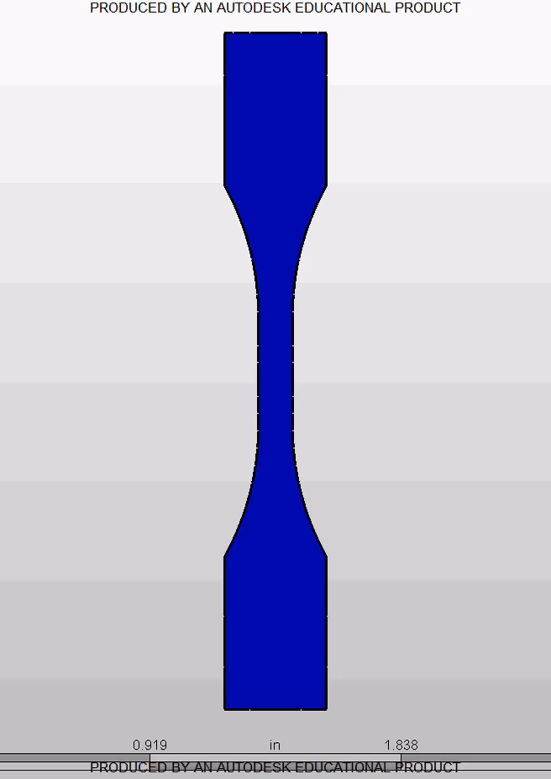
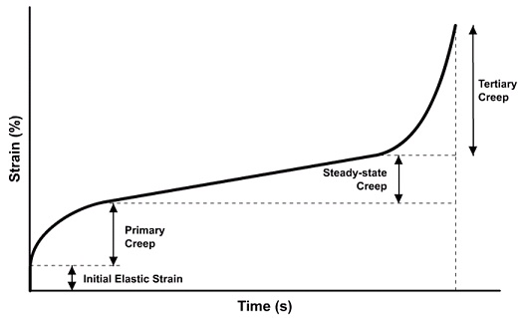
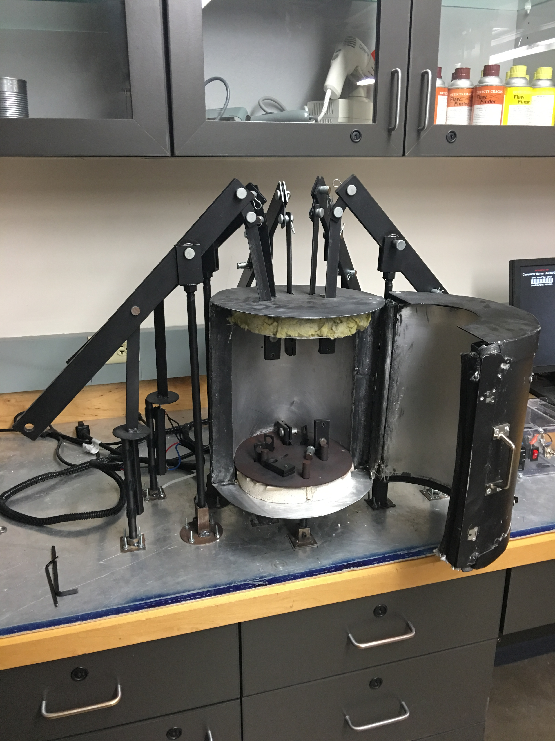
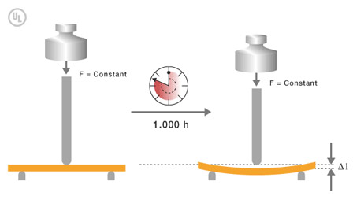

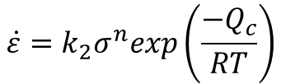
The Problem
$$\dot{ε}=k_{2}σ^{n}exp\left(\frac{−Q_{c}}{RT}\right)$$
$$\dot{ε}=k_{1}σ^{n} if T=const$$
Past Creep Test Machine
“La Araña”
Tension, Compression, Flexure

Slide 4
Project Continuation
(Functional Decomposition)
Load Application Mechanism
Sensors
Interface
Heating Source
Grips

Slide 5
Past Creep Test Machine
Load Application Mechanism: Configuration calls for safety hazard and unreliable application
Heating Source: Temperature control becomes a problem due to excessive radiation
Interface: Unable to be edited
Sensors: Data Acquisition unpredictable because of the faulty wiring
Grip System: Deformation becomes ununiformed on creep test samples

Slide 6
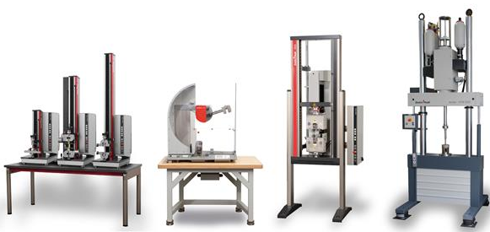
Proposed Improvements
Tensile/Compressive/Flexure Mechanism
Friendly Interface
Constant Temperature Heat Source
Easily Transported

Slide 7
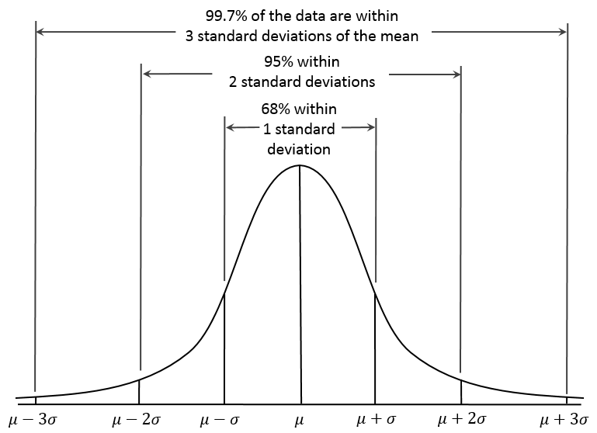
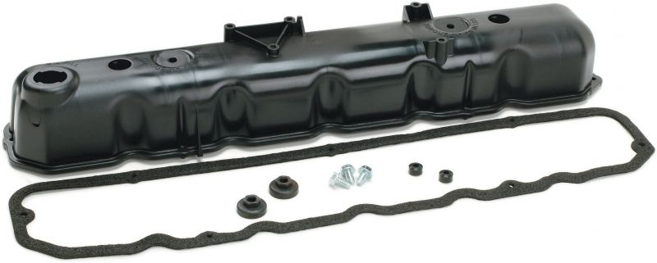
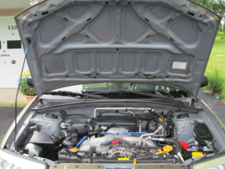
Impact
House 5 Specimen Stations for High Statistical Advantage
Improved University Lab Equipment for Education
Reduction in Average Price ~ $4775

Slide 8
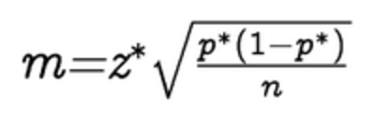
Statistical Advantages
Using the following equation:
Where m = margin of error (calculating),
p = statistical significance (0.5),
n = sample size (3,5,10),
z = z value for 95% confidence interval (1.96)
Calculated m for sample size of 3 = 56.58%, for size of 5 = 43.83%, for size of 10 = 31%.
From sample size 3-5 there is a +/- 12.75% error difference, for 5-10 there is a +/- 12.83% error difference. This leads us to believe that there is no significant increase in statistical advantage for more than 5 specimen samples.

Slide 9
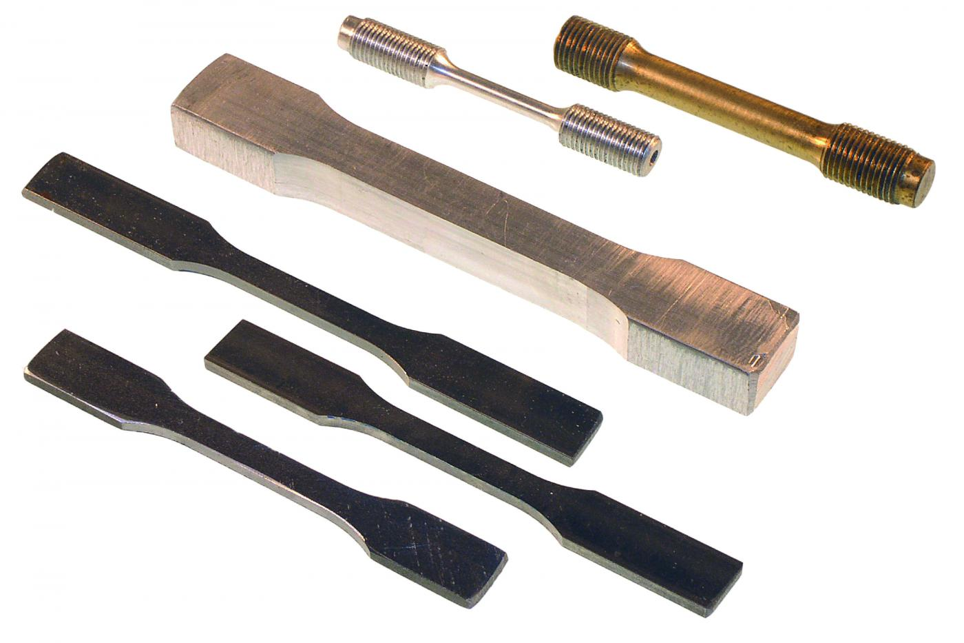
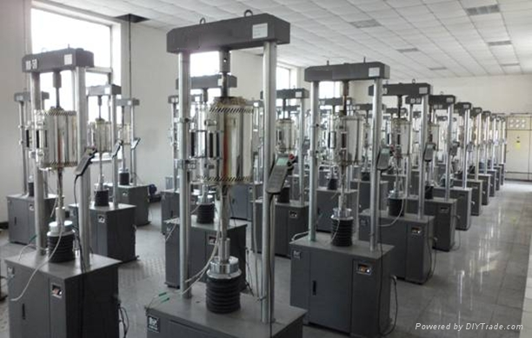


Market Status
The Market margin for Polymer Creep Testing Machines is about $15 million.
Average Price Per Unit Ranges From $4000 – $15,000
Current Competitors
MTS
Instron
ATS

Slide 10
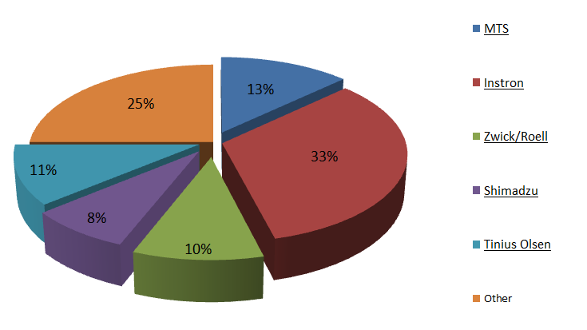
Main Creep Tester Companies

Slide 11
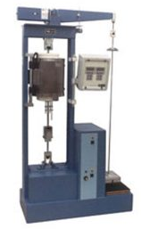

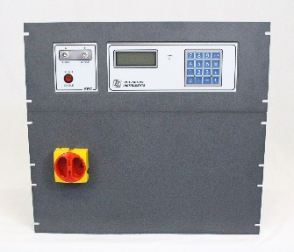

Selected Competitors
Competitor | Product | Price | Location | Website | Product Info | Contact Info
ATS – Applied Test Systems Inc. | Creep/Stress Rupture Testers | $8000 | 154 East Brook Lane Butler, PA 16002 USA | http://www.atspa.com/ | ATS Creep Testing Systems are precision lever arm testers that incorporate a number of enhanced design features. | http://www.atspa.com/contact-us/ Phone: +1-724-283-1212 Fax: +1-724-283-6570 E-mail: sales@atspa.com, service@atspa.com
Interactive Instruments, Inc. | Servo Creep System | $6000 | 704 Corporations Park Scotia, NY 12302 | http://www.interactiveinstruments.com/ | The Servo Creep Controller is designed as a substitute for dead weight stands, transforming them into a low cost automated load stroke or strain controller system. | http://www.interactiveinstruments.com/contact/ General Information: info@interactiveinstruments.com Sales: sales@interactiveinstruments.com Phone: 518 347 0955 FAX: 518 370-0728
12/9/2016
The Poly-Creep V
11

Slide 12

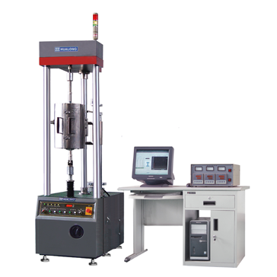

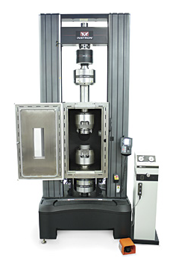
Selected Competitors
Competitor | Product | Price | Location | Website | Product Info | Contact Info
Hualong Test Instruments Corp. | Creep and Stress Rupture Testing Machine, RCW 10~500 | $7000 | Pudong New Area, Shanghai 201202, China | http://en.hualong.net/ | HUALONG RCW Series Creep and Stress Rupture testing machine is mainly designed to perform Creep and Stress Rupture testing of a wide variety of materials to both standard and customized specifications such as ASTM E139, ISO 204, ISO/R 206 and similar international standards. | http://en.hualong.net/contact.shtml TEL: +86-21-58599899 +86-21-58597668-Ext.8025 FAX: +86-21-58597568 / +86-21-58592673 MOBILE: +86-13817407606 EMAIL: sale@hualong.net MSN: hualongsales@hotmail.com SKYPE: hualongtest YAHOO:hualongtest
Instron Corporation | 5900 Series Mechanical Testing Systems | $6500 | 825 University Ave, Norwood, MA, 02062-2643, US | http://www.instron.us/en-us | The PSH8MS is typically used in hot tensile applications with tube type furnaces and consist of a separate measuring unit and suspension arm assembly. The measuring unit uses an LVDT with a fixed travel that remains outside of the furnace, the arms are located mostly inside of the heating system and attach the specimen to the measuring unit. | http://www.instron.us/en-us/our-company/contact-us Sales: +1 800 564 8378 Service: +1 800 473 7838 General Enquiries: +1 800 877 6674

Slide 13
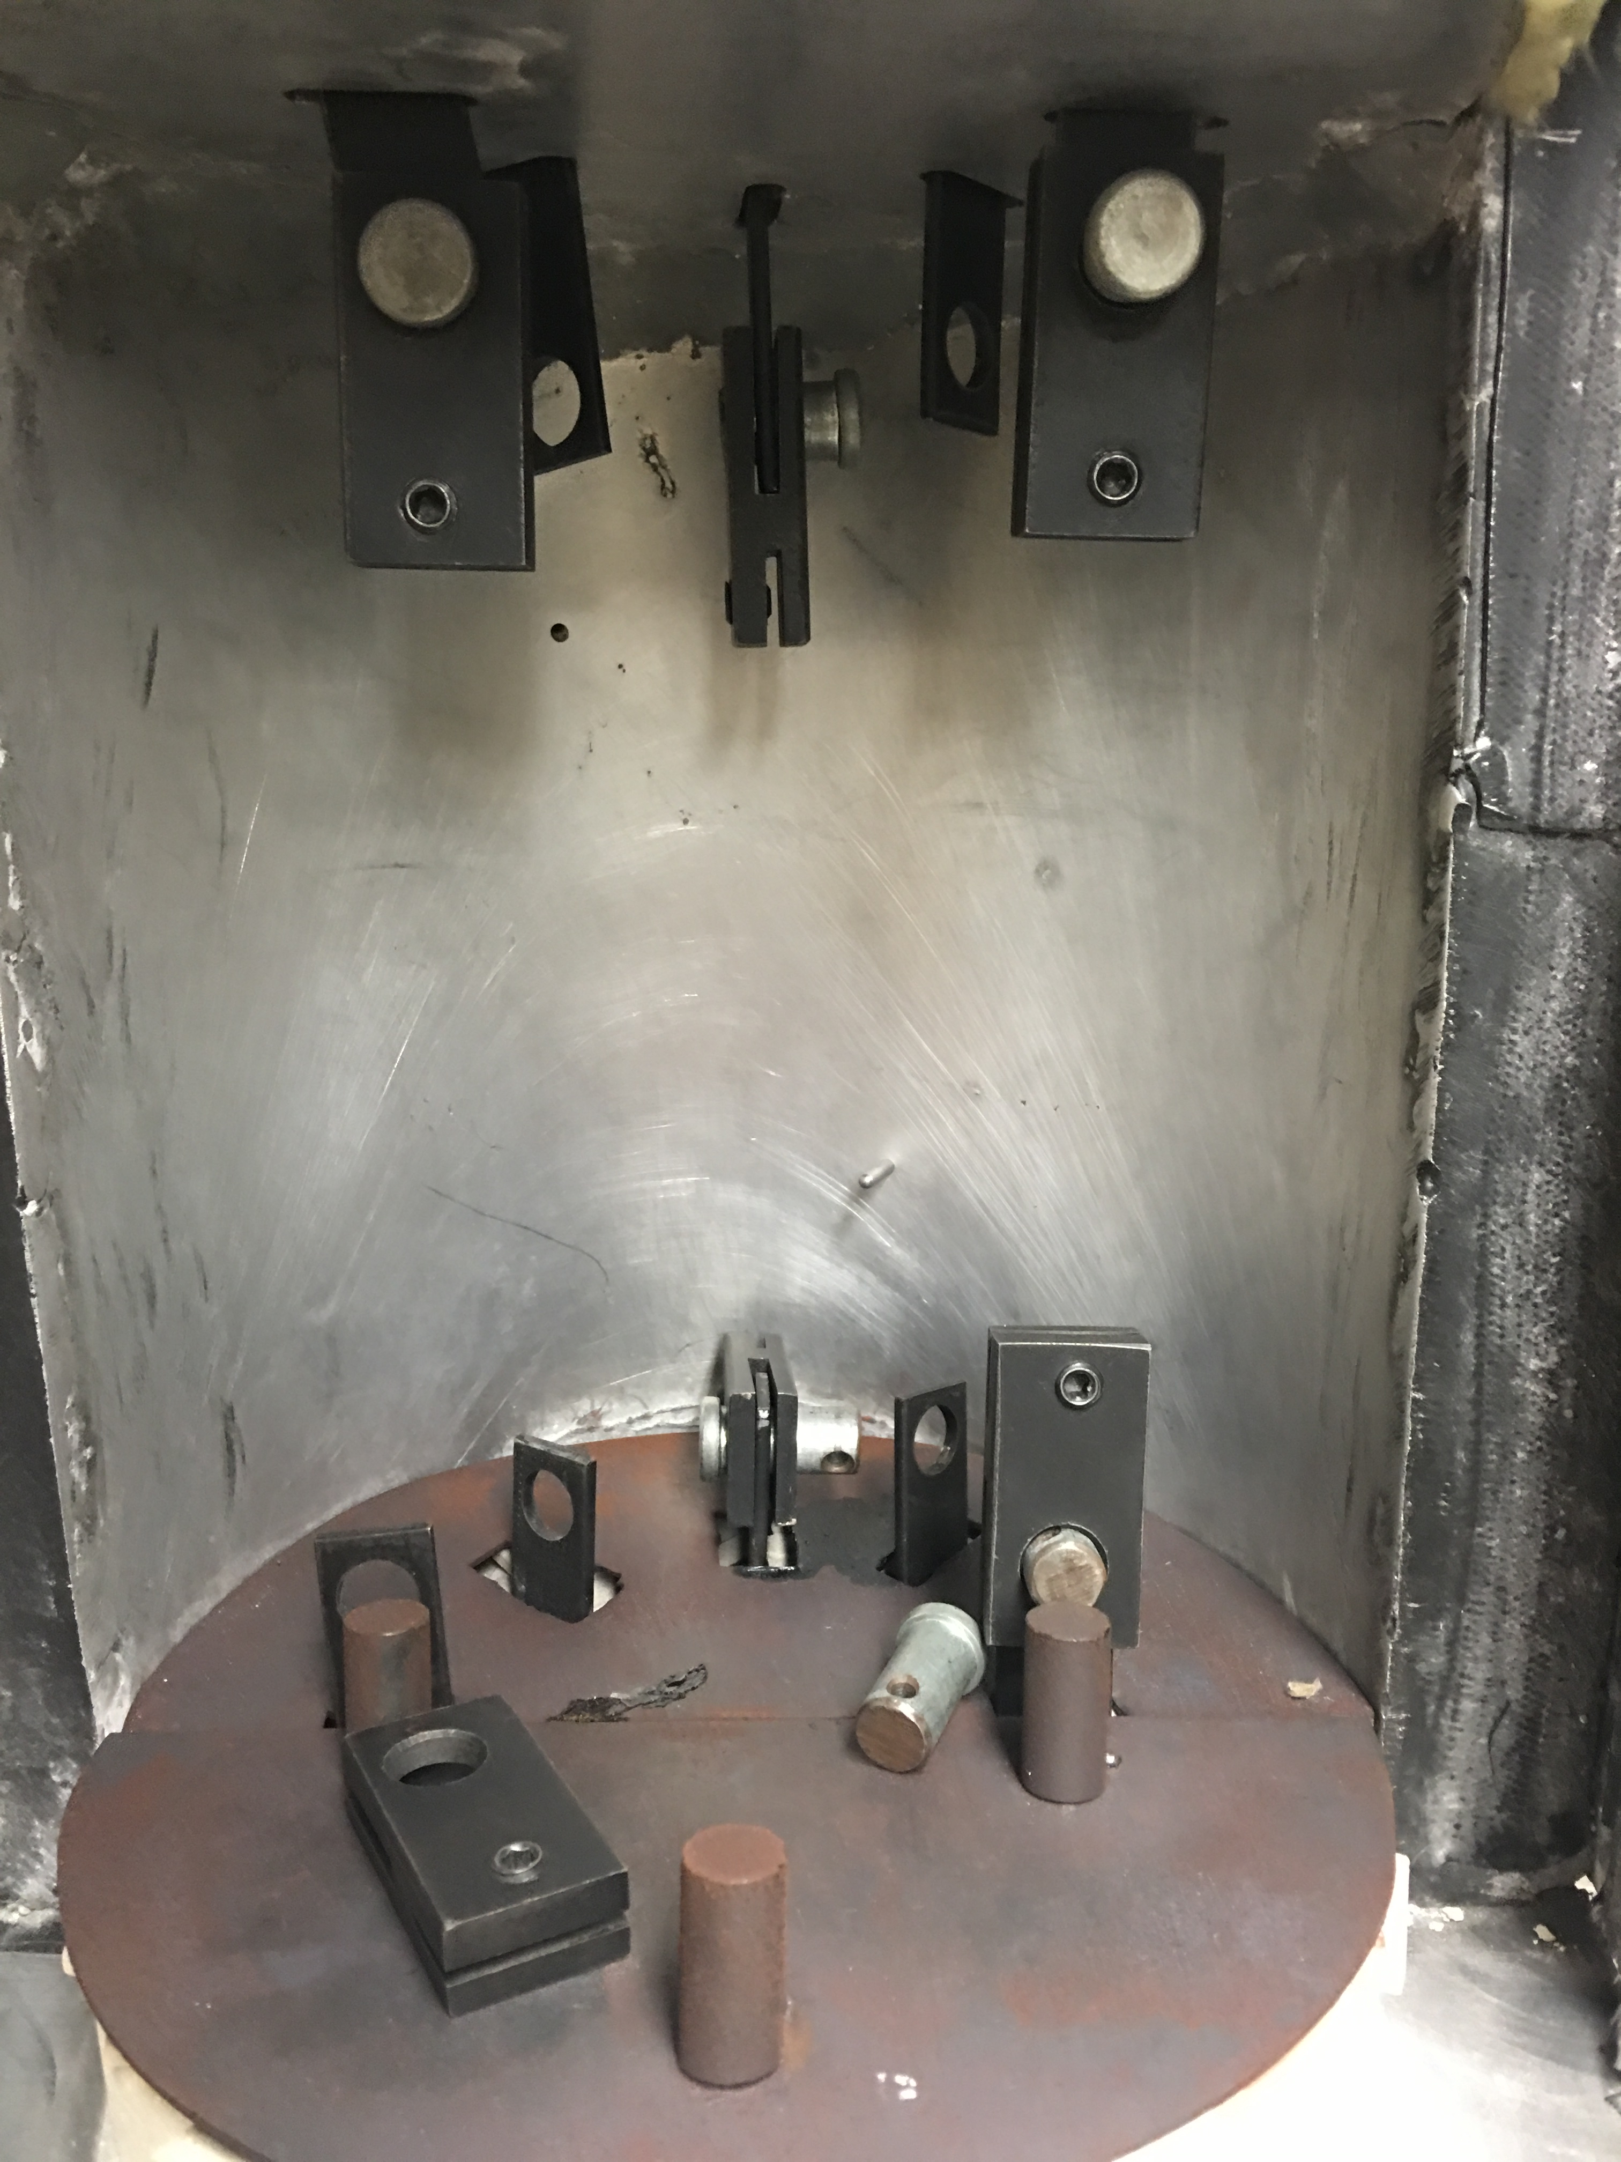
Goals:
A device that is
Financially Feasible
User Friendly
Able to provide accurate deflection on the specimens
Objectives:
Three Modes of Creep Testing
Static Loading Mechanism
Reaching Steady State Equilibrium
Obtaining Data from Arduino into Excel and/or Matlab

Slide 14

Needs and Wants
Needs:
Mobility
Multi-Specimen Testing
Quick Output Response
Constant Loading
Wants:
Aesthetic Appeal
Inexpensive
User Friendly
Interchangeable Parts

Slide 15
Quality Function Deployment (QFD)

Slide 16
Needs/Wants vs. Engineering Parameters

Slide 17
Needs/Wants vs. PolyCreep V & Competitors

Slide 18
Technical Evaluation of Companies
Direction of Improvement
Customer Requirements (What) | Design Requirements (How) | Importance (1-5) | Actuator Displacement (in) | Temperature Range (˚C ) | Weight System (lb) | Grip Clearance (in) | Constant Temperature Chamber (ºC) | Input Voltage (V) | Labview Output Plot (ºC/in) | Thermo-resistance Camera (˚C) | Cost $
 | The PolyCreep V |  | <6 | 20-210 | <100 | 0.75 | 210 | 24 | - | - | 2100
Technical | ATS - Applied Test Systems Inc. |  | <.5 | 60-175 | <60 | - | - | 36 | - | - | 8000
Evaluation | Interactive Instruments, Inc. |  | <2.5 | 45-250 | <80 | - | - | 48 | - | - | 6000
 | Instron Corporation |  | - | 30-350 | <200 | - | - | 60 | - | - | 6500
 | Hualong Test Instruments Corp. |  | - | 50-200 | <20 | - | - | 120 | - | - | 7000

Slide 19
Engineering Parameters

Slide 20

Concept Selection
Functional Decomposition
Subcomponents
Concept Variants (as many as possible)
Design Constraints
Final Selection of Subcomponents (from design constraints)
Combining all Subcomponents into a final design.

Slide 21
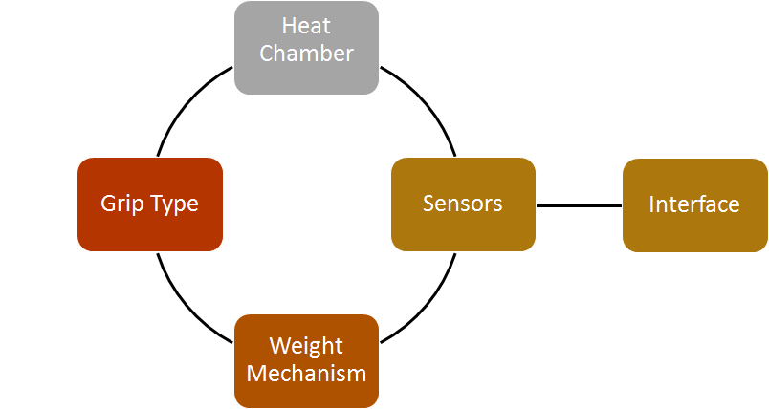
Functional Decomposition

Slide 22
Pairing-Method Matrix
Sensors | Accuracy | Calibration | Reliability | Total | Nominal Score
Accuracy | x | 4 | 4 | 8 | 0.615
Calibration | 2 | x | 3 | 5 | 0.385
Reliability | 3 | 2 | x | 5 | 0.385
Total | 2 | 4 | 7 | 13 | 1
Accuracy | Thermistors | Thermocouple | Fluid Expansion | Infrared | Total | Nominal Score
Thermistors | x | 2 | 3 | 2 | 7 | 0.241
Thermocouple | 4 | x | 2 | 2 | 8 | 0.276
Fluid Expansion | 3 | 3 | x | 1 | 7 | 0.241
Infrared | 2 | 3 | 2 | x | 7 | 0.241
Total | 9 | 8 | 7 | 5 | 29 | 1
Calibration | Thermistors | Thermocouple | Fluid Expansion | Infrared | Total | Nominal Score
Thermistors | x | 1 | 3 | 2 | 6 | 0.214
Thermocouple | 2 | x | 4 | 4 | 10 | 0.357
Fluid Expansion | 3 | 2 | x |  | 5 | 0.179
Infrared | 2 | 2 | 3 | x | 7 | 0.250
Total | 7 | 5 | 10 | 6 | 28 | 1
Reliability | Thermistors | Thermocouple | Fluid Expansion | Infrared | Total | Nominal Score
Thermistors | x | 2 | 1 | 3 | 6 | 0.231
Thermocouple | 2 | x | 2 | 3 | 7 | 0.269
Fluid Expansion | 2 | 1 | x | 2 | 5 | 0.192
Infrared | 1 | 3 | 4 | x | 8 | 0.308
Total | 5 | 6 | 7 | 8 | 26 | 1

Slide 23

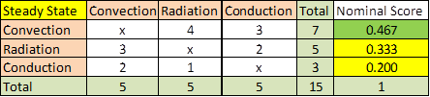
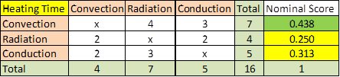
Pairing-Method Matrix Example

Slide 24
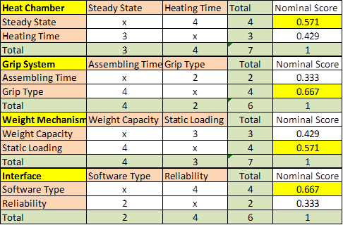
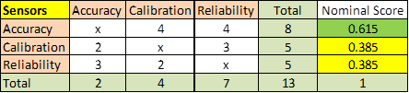

Slide 25
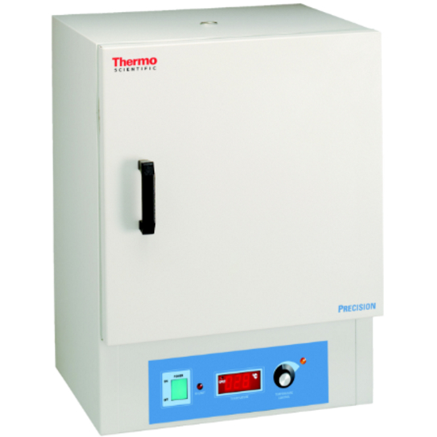

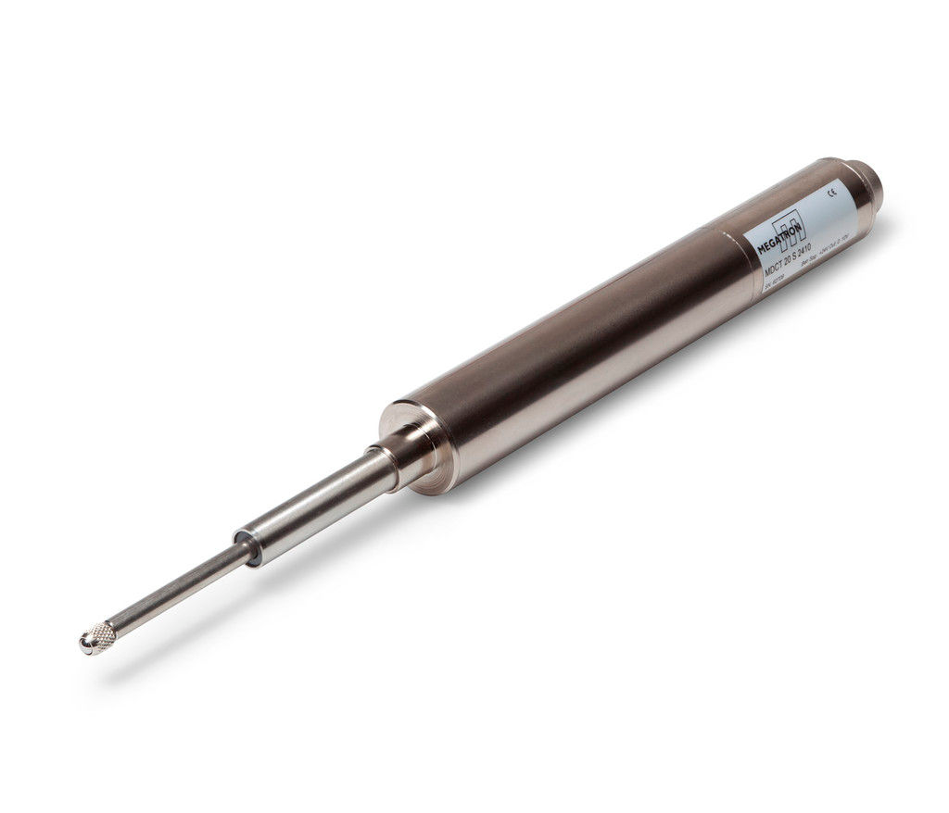
Summary of Components
Component | Driven By
Heat Chamber | Steady State
Grip System | Grip Type
Weight Mechanism | Static Loading
Sensors | Accuracy
Interface | Software Type

Slide 26
Heat Chamber
Design Constraints
Time to Steady State
Temperature Control
Insulation
Concept Variants
Convection
Radiation
Conduction

Slide 27
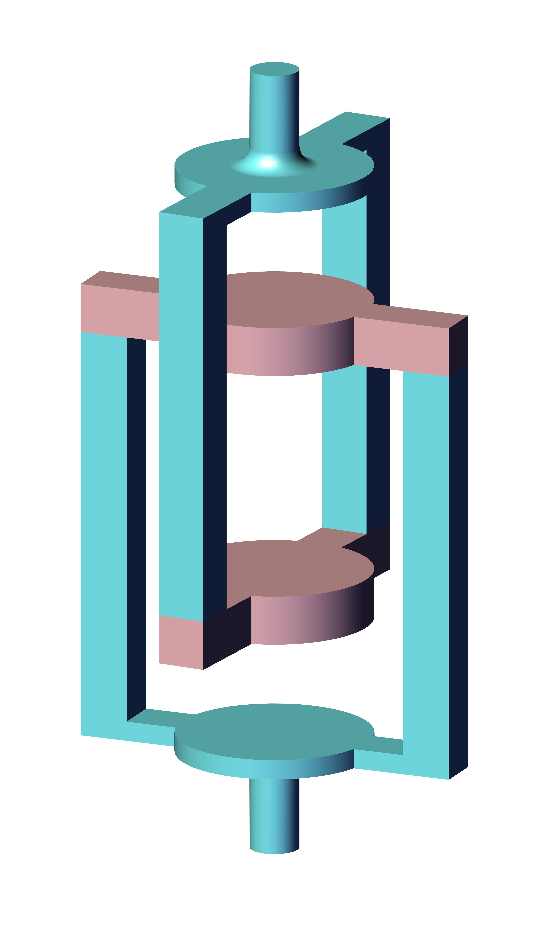
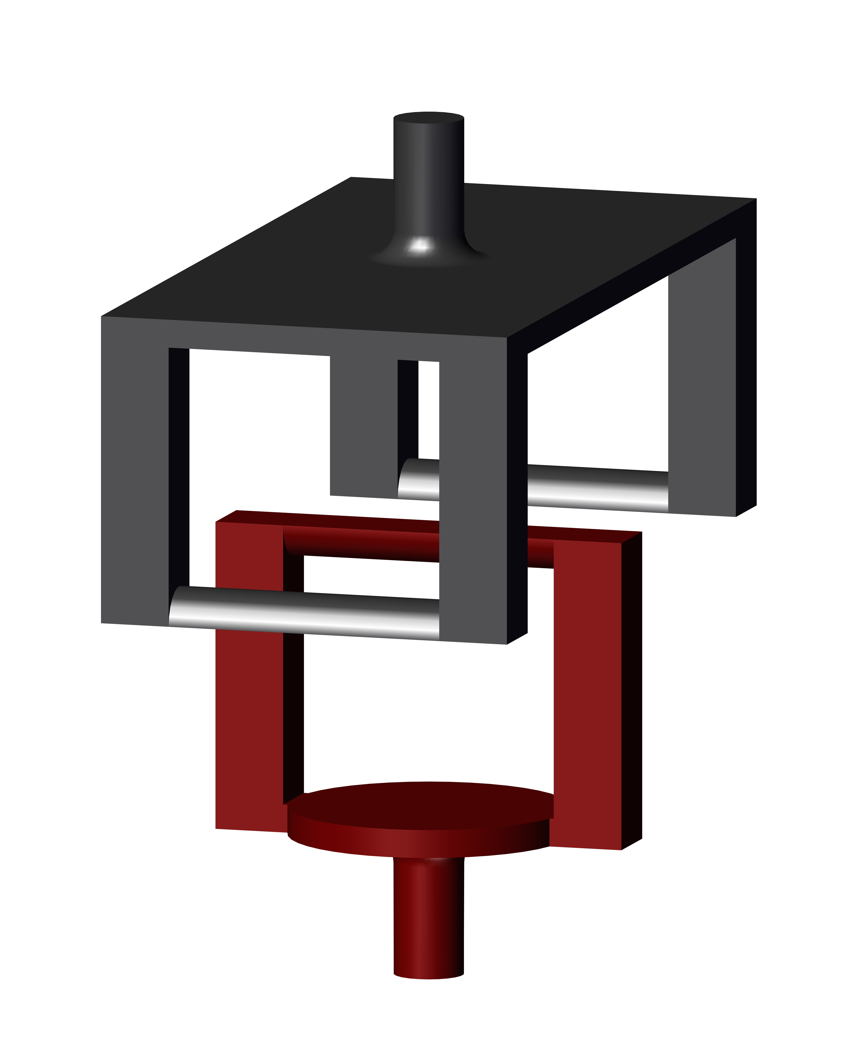
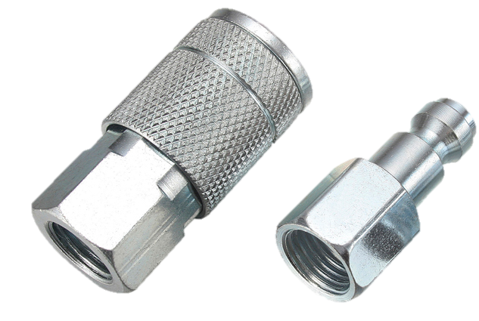
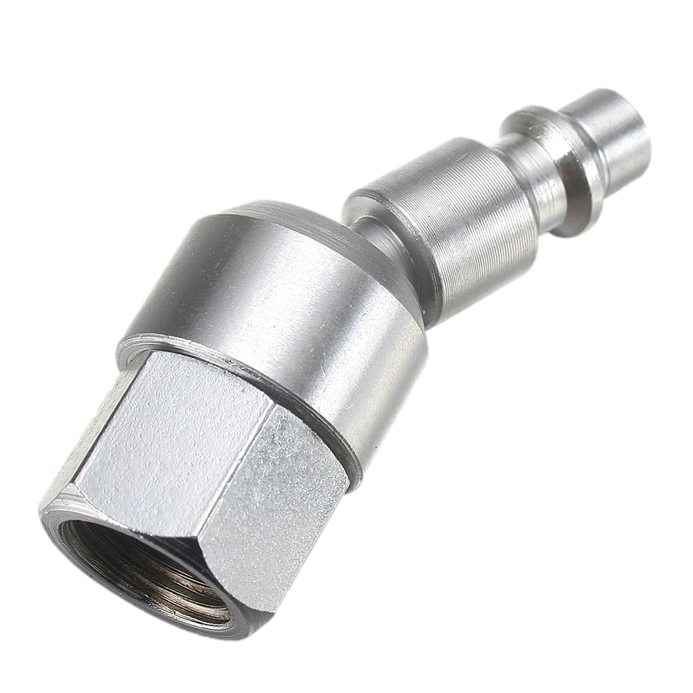
Grip System
Design Constraints:
Assembling Time
Grip Type
Concept Variants:
Quick Connects
Rigid Clamps
Bolt Clamp
Grip Type Used
Tensile
Compression Plates
3-Point Flex
Compression Plates
3-Point
Flexural Supports
Tensile
Wedge Grips
Quick
Connects

Slide 28
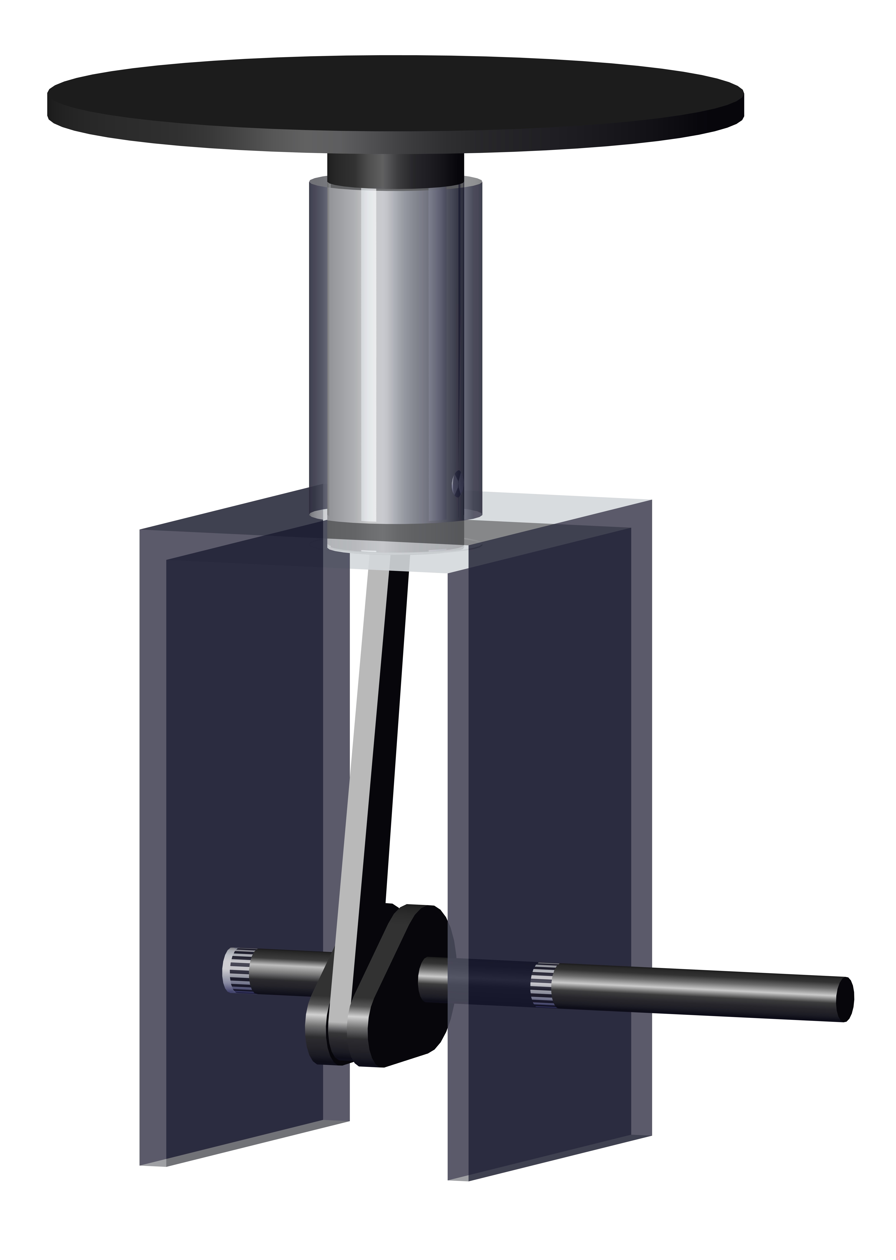
Weight Mechanism
Design Constraints:
Weight Capacity
Static Loading
Concept Variants:
Lever Application
Gravity Driven
Hydraulic Press
Crank Lift
Motor Driven
Linear Actuators

Slide 29
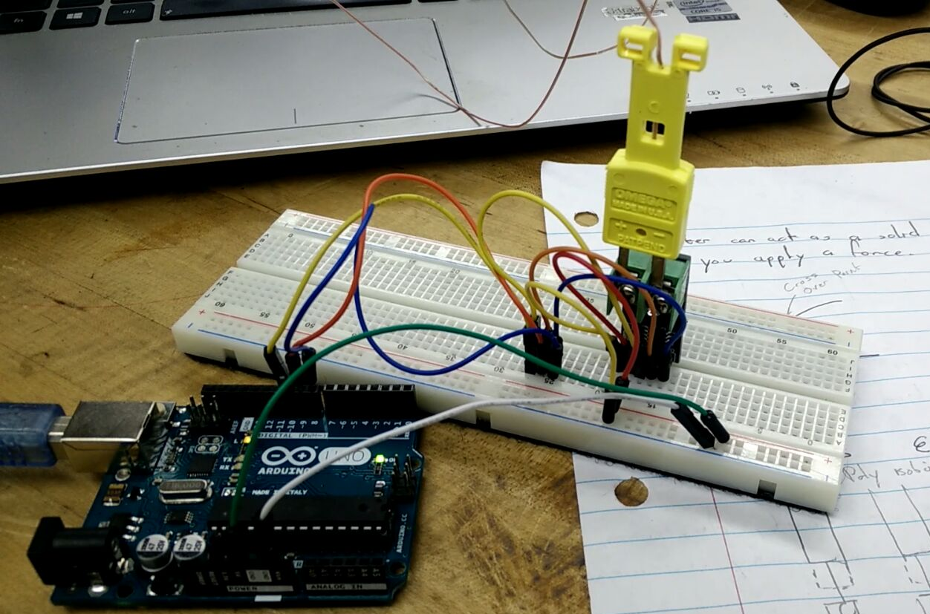
Sensors
Concept Variants:
For Length:
Linear Potentiometers
Liner Variable Displacement Transducer
Ultrasonic Range Finder
Laser Distance Finder
For Temperature:
Thermocouple
Thermistors
Fluid Expansion
Infrared Thermometer
Design Constraints:
Accuracy
Calibration
Reliability

Slide 30


Interface/Data Collection
Design Constraints:
Software Type
Reliability
Concept Variants:
LabVIEW (CM)
myOpenLab (OS)
Flowstone (CM)
Parlay (OS)
Arduino (OS)
Raspberry Pi (OS)
Python (OS)
Data Display Software
Excel (CM)
Matlab (CM)
CM = Commercial
OS = Open Source

Slide 31
Grip Mechanisms
3-Point Flexural Supports
Compression Plates
Tensile Wedge Grips

Slide 32
Heat Chamber
Convection Chamber
Heat transfer rate more easier to control compared to other types of heat chamber.
Thermostat controls the temperature of the chamber in order to maintain the steady state required for the test.

Slide 33
Weight Application
Crank Lift Mechanism
  Produces a linear displacement at a constant controllabe rate, that when applied to the samples, generates quasi-static loading.
Capacity loading withstand the weight that the samples will be loaded at.

Slide 34

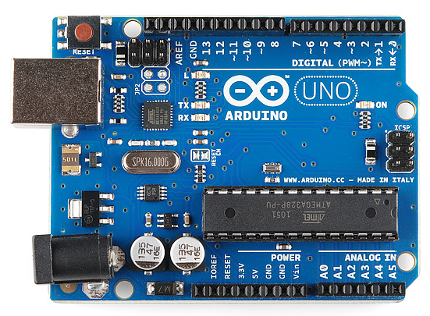
Interface
Arduino/ Excel
LabView provides a user-friendly and editable data collection system.
National Instruments card allows for analogue signal to digital conversion easily using LabView interface

Slide 35
Proposed Design
Heating Source
Interface
Sensors
Grips
Load
Application Mechanism

Slide 36
Engineering Analysis
Topics | Subcomponents
Materials Science | Load Application
Mechanics of Solids
Kinematics and Dynamics | Load Application Mechanism
Machine Elements
Heat Transfer | Heat Chamber

Slide 37
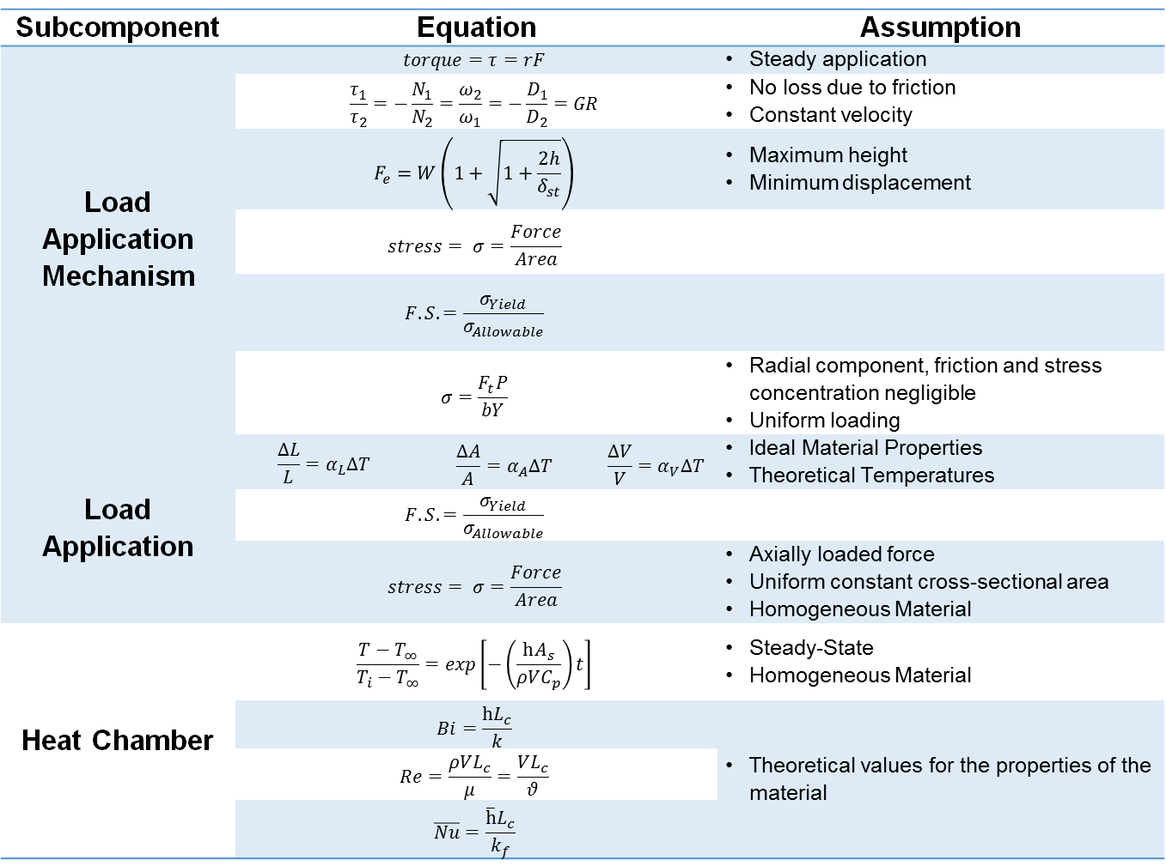
Engineering Equations & Assumptions
Subcomponent | Equation |  |  | Assumption
Load Application Mechanism | $$torque=τ=rF$$ |  |  | Steady application
 | $$\frac{τ_{1}}{τ_{2}}=−\frac{N_{1}}{N_{2}}=\frac{ω_{2}}{ω_{1}}=−\frac{D_{1}}{D_{2}}=GR$$ |  |  | No loss due to friction Constant velocity
 | $$F_{e}=W\left(1+\sqrt{1+\frac{2h}{δ_{st}}}\right)$$ |  |  | Maximum height Minimum displacement
 | $$stress= σ=\frac{Force}{Area}$$
 | $$F.S.=\frac{σ_{Yield}}{σ_{Allowable}}$$
 | $$σ=\frac{F_{t}P}{bY}$$ |  |  | Radial component, friction and stress concentration negligible Uniform loading
Load Application | $$\frac{∆L}{L}=α_{L}∆T$$ | $$\frac{∆A}{A}=α_{A}∆T$$ | $$\frac{∆V}{V}=α_{V}∆T$$ | Ideal Material Properties Theoretical Temperatures
 | $$F.S.=\frac{σ_{Yield}}{σ_{Allowable}}$$
 | $$stress= σ=\frac{Force}{Area}$$ |  |  | Axially loaded force Uniform constant cross-sectional area Homogeneous Material
Heat Chamber | $$\frac{T−T_{∞}}{T_{i}−T_{∞}}=exp\left[−\left(\frac{hA_{s}}{ρVC_{p}}\right)t\right]$$ |  |  | Steady-State Homogeneous Material
 | $$Bi=\frac{hL_{c}}{k}$$ |  |  | Theoretical values for the properties of the material
 | $$Re=\frac{ρVL_{c}}{μ}=\frac{VL_{c}}{θ}$$
 | $$\overline{Nu}=\frac{\overline{h}L_{c}}{k_{f}}$$

Slide 38
Nomenclature
Nomenclature
A = area
Bi = Biot number
C_{p} = specific heat
F = force
F.S. = factor of safety
h = height
k = thermal conductivity
L = length
N = number of gear teeth
P = pitch
r = radius
Re = Reynold’s number
T = temperature
t = time
V = velocity
W = weight
Greek
∀ = volume
α = coefficient of thermal expansion
δ = displacement
ϑ = kinematic viscosity
μ = dynamic viscosity
ρ = density
σ = stress
τ = torque

Slide 39
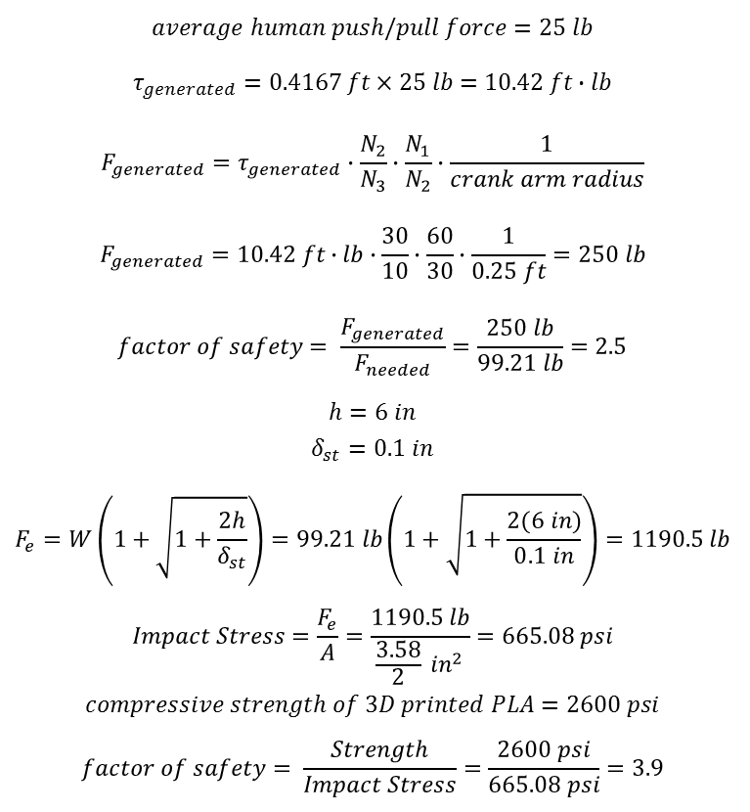
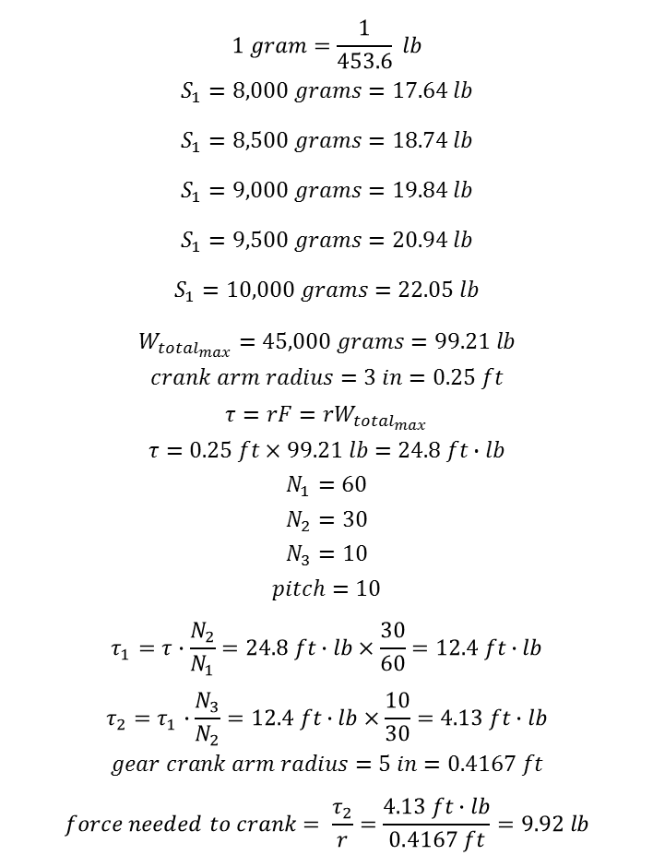
$$1 gram=\frac{1}{453.6} lb \\ S_{1}=8,000 grams=17.64 lb$$
$$S_{1}=8,500 grams=18.74 lb$$
$$S_{1}=9,000 grams=19.84 lb$$
$$S_{1}=9,500 grams=20.94 lb$$
$$S_{1}=10,000 grams=22.05 lb$$
$$W_{{total}_{max}}=45,000 grams=99.21 lb$$
$$crank arm radius=3 in=0.25 ft$$
$$τ=rF=rW_{{total}_{max}}$$
$$τ=0.25 ft×99.21 lb=24.8 ft∙lb$$
$$N_{1}=60$$
$$N_{2}=30$$
$$N_{3}=10$$
$$pitch=10$$
$$τ_{1}=τ∙\frac{N_{2}}{N_{1}}=24.8 ft∙lb×\frac{30}{60}=12.4 ft∙lb$$
$$τ_{2}=τ_{1}∙\frac{N_{3}}{N_{2}}=12.4 ft∙lb×\frac{10}{30}=4.13 ft∙lb$$
$$gear crank arm radius=5 in=0.4167 ft$$
$$force needed to crank= \frac{τ_{2}}{r}=\frac{4.13 ft∙lb}{0.4167 ft}=9.92 lb$$
$$average human push/pull force=25 lb$$
$$τ_{generated}=0.4167 ft×25 lb=10.42 ft∙lb$$
$$F_{generated}=τ_{generated}∙\frac{N_{2}}{N_{3}}∙\frac{N_{1}}{N_{2}}∙\frac{1}{crank arm radius}$$
$$F_{generated}=10.42 ft∙lb∙\frac{30}{10}∙\frac{60}{30}∙\frac{1}{0.25 ft}=250 lb$$
$$factor of safety= \frac{F_{generated}}{F_{needed}}=\frac{250 lb}{99.21 lb}=2.5$$
$$h=6 in$$
$$δ_{st}=0.1 in$$
$$F_{e}=W\left(1+\sqrt{1+\frac{2h}{δ_{st}}}\right)=99.21 lb\left(1+\sqrt{1+\frac{2(6 in)}{0.1 in}}\right)=1190.5 lb$$
$$Impact Stress=\frac{F_{e}}{A}=\frac{1190.5 lb}{\frac{3.58}{2} {in}^{2}}=665.08 psi$$
$$compressive strength of 3D printed PLA=2600 psi$$
$$factor of safety= \frac{Strength}{Impact Stress}=\frac{2600 psi}{665.08 psi}=3.9$$

Slide 40
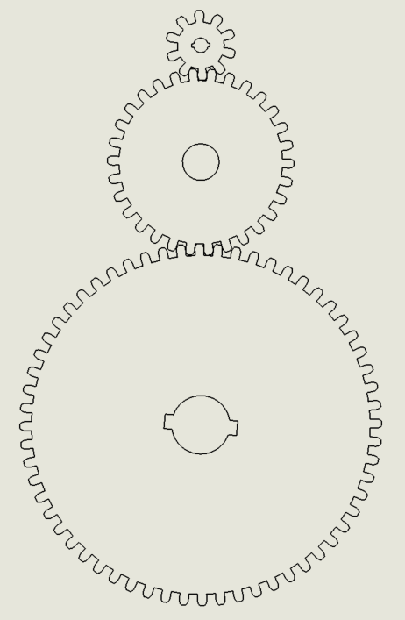
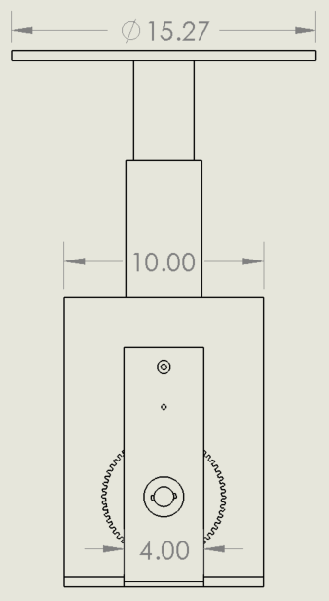
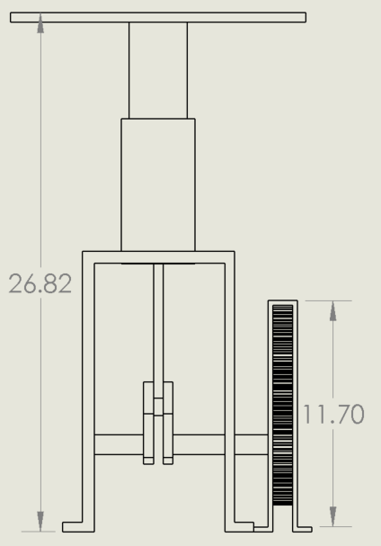
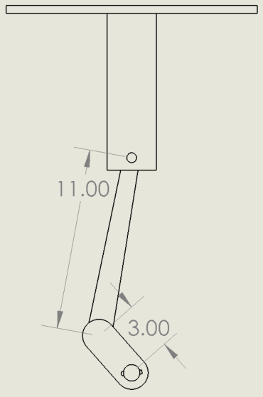
Load Application Mechanism
N=10
DP = 10
PD = 1 in
N=30
PD = 3 in
N=60
PD = 6 in
Total Weight | 99.21 lb.
Force Needed to Lift | 9.92 lb.
Average Human Push/Pull Force | 25 lb.
Lifting Force Generated by Mechanism | 250 lb.
Factor of Safety | 2.5
Impact Stress | 665.08 psi
Compressive Strength of PLA | <2600 psi
Factor of Safety | 3.9

Slide 41
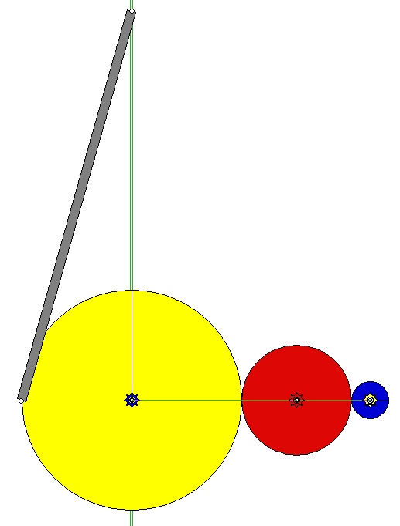
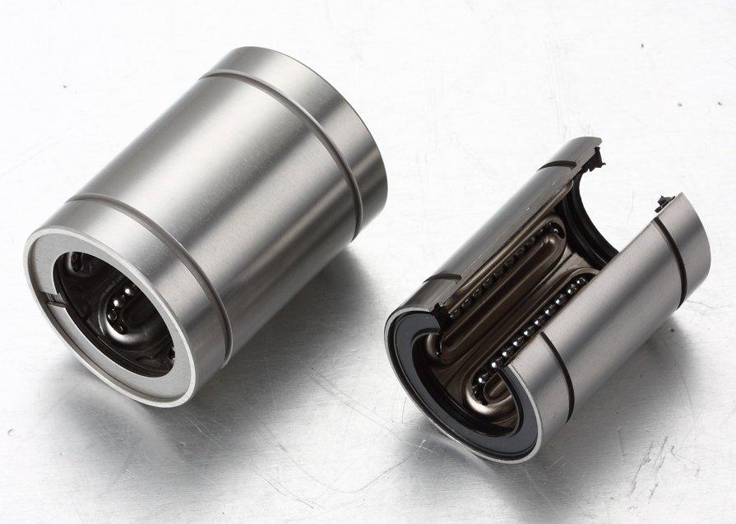
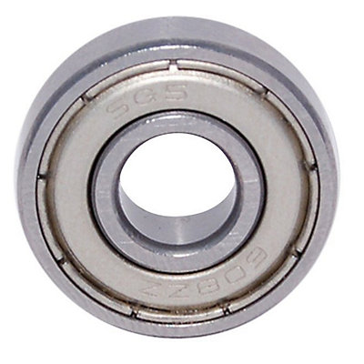
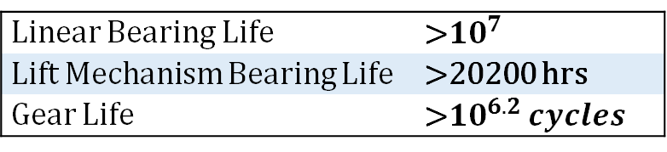
Load Application Mechanism
Moment Applied (lb-in) | Lewis Bending Stress (ksi) | Bending Strength of PLA (ksi)
62.52 | 7.41 | <8.97
125.04 | 3.52 | < 8.97
375.12 | 2.62 | < 8.97
Angular Velocity Input | 0.597 rev/sec
Angular Velocity Output | 0.0995 rev/sec
Lifting/Lowering Velocity (max) | 1.954 in/sec
Loading Time | 5 sec
Linear Bearing Life | >${10}^{7}$
Lift Mechanism Bearing Life | >20200 hrs
Gear Life | >${10}^{6.2} cycles$
*Working Model 2D Analysis

Slide 42
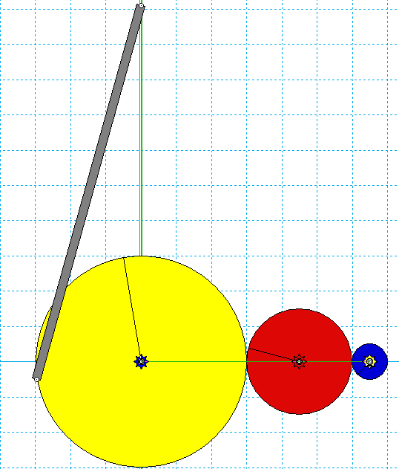
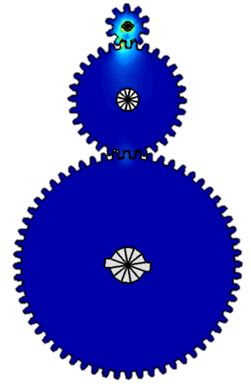
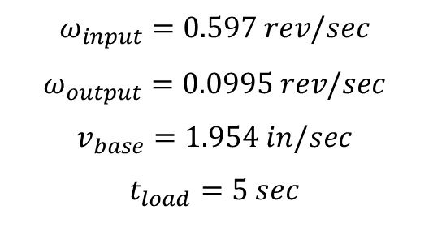
$$ω_{input}=0.597 rev/sec$$
$$ω_{output}=0.0995 rev/sec$$
$$v_{base}=1.954 in/sec$$
$$t_{load}=5 sec$$

Slide 43
Gear Tooth Lewis Equation Bending Moment (MATLAB)
%%Forces on Teeth
M = [10.42 31.26 62.52];
r = [.5 1.5 3];
Ft = [M(1)*12/r(1) , M(2)*12/r(2), M(3)*12/r(3)];
P = [10 10 10];
b = [1 1 1];
Y = [.176 .318 .355];
for n=1:3
sigma = Ft(n)*P(n)/(b(n)*Y(n))
end

Slide 44
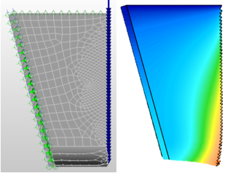
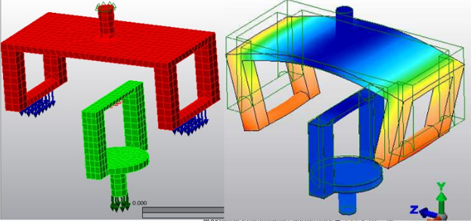
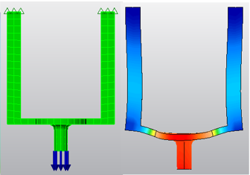
Grip Analysis
Maximum Displacement Magnitude = 2.17E-6 in
Maximum Displacement Magnitude = 0.0096 in
Maximum Displacement Magnitude = 7.88E-4 in

Slide 45
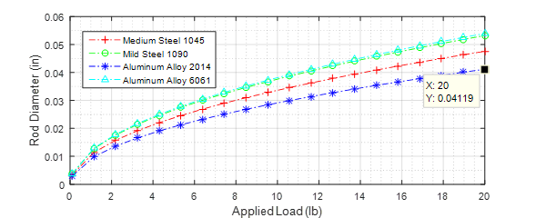
Solutions & Results
Aluminum Alloy 2014
Minimum Rod Diameter = 0.04119 in
Chosen Rod Diameter = ¼”

Slide 46

Solutions & Results
Aluminum Alloy 2014
Factor of Safety = 147.4

Slide 47

Solutions & Results
Aluminum Alloy 2014
Calculated Diameter Expansion at 220° =

Slide 48

Design for:
Manufacturability – Parts with Symmetry, Minimize Cutting Tools/Setups
Safety - Automatic shut-off
Environment – Hazardous materials, renewable materials
Reliability – Cyclic life for the grip and rod materials are considered
Maintainability – Components are designed to be easy and quick to replace

Slide 49
Design for:
Manufacturability – Parts with Symmetry, Minimize Cutting Tools, Minimize Setups.
Safety – Special thermocouple sensors for automatic shut-off, special switch for excess displacement on the rods.
Environment – Avoid Hazardous materials, renewable materials, minimum waste production, clear instructions on cleaning/use/repair, mark wear locations on parts.
Reliability – Cyclic life for the grip and rod materials are considered.
Maintainability – Components are designed to be easy and quick to replace.

Slide 50

Bill of Materials
Quantity | Item Name | Price Per Unit | Price Total
4 | Arduino | 23.99 | 95.96
1 | Cables | 7.89 | 7.89
5 | Thermocouple Modules | 8.4 | 42
1 | Filament | 14.49 | 14.49
1 | Filament | 17.17 | 17.17
1 | Python Guide | 25.45 | 25.45
1 | Circuit Board | 5.17 | 5.17
1 | Filament | 16.99 | 16.99
1 | Breadboards | 8.99 | 8.99
3 | Bearing | 7.32 | 21.96
3 | Bearing | 17.32 | 51.96
44 | Nuts & Bolts | 0.5 | 22
5 | Connector Kit | 5.96 | 29.8
1 | Plexiglas | 40 | 40
 | Total | 199.64 | 399.83
Notes:
Better Pictures of Materials

Slide 51

Engineering Economics/Production Cost
Company Section Point of View
Parameters considered:
Employees
Manager
Lease
Utilities
Material Cost (from bill of materials)
Equipment
Depreciation
Overhead Expenses
Conclusion: Would need to produce different products in order to be profitable .
Final Results
Sales Revenue | 1050000
Total Cost | 827170.4
Net Income | 222829.6
Gross Profit | 827320
Return on Sales | 0.21

Slide 52
Engineering Economics/Production Cost
Expenses (Production Costs)
Labor:
Labor Price Per Hour | Labor Hours | Total
18 | 60 | 1080
Supervisor Salary | Supervisor Hours
26 | 12 | 312
Benefits for Employees(vacations, leave, 401k, etc.) |  | 324
Benefits for Supervisors(vacations, leave, 401k, etc.) |  | 93.6
Production Volume Per Year |  | 150
Number of Employees | (4 Per Device) | 37.5
Total Labor Per Employee |  | 1404
Total Labor (37 Employees) |  | 51948
Supervisor Salary Total (7 Supervisors) |  | 2839.2
Estimated Labor For Production Volume |  | 54787.2
Lease:
Average Price Per Square Foot (Monthly) | Total Area (ft^2)
23.23 | 660 | 15331.8
Yearly Rent (12 Months) |  | 183981.6
Utilities
Electricity (Monthly) | (1.34 per ft^2) | 884.4
Water (Yearly) | (2.70 per ft^2) | 1782
Electricity (Yearly) |  | 10612.8
Total Utilities Cost |  | 12394.8
Material Cost
Oven |  | 2000
Computer |  | 200
Cart |  | 50
Reference Back to Sheet 1 for Parts List |  | 399.83
Total Material Cost Per Creep Tester |  | 2649.83
Total Cost Yearly for Creep Testers |  | 397474.5
Equipment | Quantity
Soldering Iron | (6 Average Needed) | 30
Band saw | 1 | 2700
Grinding Machine | 1 | 400
Basic Assembly Equipment | 1 | 200
Total Equipment |  | 3330
Depreciation
Band saw | 10 year linear | 270
Grinding Machine | 10 year linear | 40
Basic Assembly Equipment | 5 year linear | 40
Total Depreciation |  | 350
Overhead Expense
30% of Total Labor Cost to Cover up for Insurance, Parking and Other Expenses. |  | 30%
 |  | 16436.16
Total Cost Analysis
Direct Costs |  | 464656.5
Indirect Cost |  | 187661.6
Overhead Expense |  | 16436.16
Distributors (Estimated from Revenue) | 5% | 37500
Retail Cost (Estimated from Revenue) | 5% | 37500
Total Cost |  | 743754.3
Revenues (Product Sales)
Price Per Unit(Estimated) | 5000
Quantity Sold (Estimated) | 150
Sale Revenue | 750000
Final Results
Sales Revenue | 750000
Total Cost | 743754
Net Income | 6245.74
Gross Profit | 297738.3
Gross Profit Margin | 40%

Slide 53

Cost of Prototype
The cost of the prototype was estimated from the Bill of the Materials and the pre-selected devices required for this project.
Convection Oven $1200
PC System $500
Transportation Cart $40
Items from the Bill of Materials $400
Total ~ $2100

Slide 54




Manufacturing Process Details
Components:
Grips
Gears
Alignment System
Heat Chamber
Process:
3-D Printing
CNC
Lathe Machine
Drilling

Slide 55
Design Failure Mode Analysis (DFMEA)
Part/Component | Failure Mode | Severity | Frequency | Detectability | Risk Priority Number
Oven | Overheating | 10 | 3 | 2 | 60
Oven | Significant Heat loss | 4 | 2 | 2 | 16
Sensors | Interference/malfunction | 3 | 3 | 3 | 27
Rods with Grips | Misalignment | 3 | 2 | 1 | 6
Gears | Failure due impact | 2 | 3 | 1 | 6

Slide 56

Test Protocols
Potentiometers – Manual Measuring at set displacements (Already verified)
Crank Lift Mechanism – Torque amplification (To be performed)
Uniform Heat Convection – Thermocouple measuring at different points (Already verified)

Slide 57


Linear Potentiometers – Manual Measurement Analysis
Measurements taken manually from ruler
Data compared to Arduino code

Slide 58

Uniform Heat Convection
Data analyzed from different points in the heat chamber
Same analysis expected once built
Point | Uncertainty ( ±C) from Omega.com | Mean ( C ) | Standard Deviation ( ± C) | Sampling Rate (Hz) | Time Constant (sec)
1 | 1.1 | 197.1 | 1.00 | 100 | 364
2 | 1.1 | 195.2 | 2.16 | 100 | 360
3 | 1.1 | 203.3 | 2.16 | 100 | 313
4 | 1.1 | 206.1 | 1 | 100 | 262

Slide 59

Statistical Results for Uniform Convection
At least 2200 seconds or 37 minutes for temperature result convergence

Slide 60
MATLAB Code For Temperature Distribution
clc; close all
%% Initialize variables.
filename1 = 'C:\Users\Jacome Jr\Documents\MATLAB\D1.csv';
filename2 = 'C:\Users\Jacome Jr\Documents\MATLAB\D1T2.csv';
filename3 = 'C:\Users\Jacome Jr\Documents\MATLAB\D2.csv';
filename4 = 'C:\Users\Jacome Jr\Documents\MATLAB\D2T2.csv';
delimiter = ',';
%% Format string for each line of text:
% column1: double (%f)
% column2: double (%f)
% For more information, see the TEXTSCAN documentation.
formatSpec = '%f%f%[^\n\r]';
%% Open the text file.
fileID1 = fopen(filename1,'r');
fileID2 = fopen(filename2,'r');
fileID3 = fopen(filename3,'r');
fileID4 = fopen(filename4,'r');
%% Read columns of data according to format string.
% This call is based on the structure of the file used to generate this
% code. If an error occurs for a different file, try regenerating the code
% from the Import Tool.
dataArray1 = textscan(fileID1, formatSpec, 'Delimiter', delimiter, 'ReturnOnError', false);
dataArray2 = textscan(fileID2, formatSpec, 'Delimiter', delimiter, 'ReturnOnError', false);
dataArray3 = textscan(fileID3, formatSpec, 'Delimiter', delimiter, 'ReturnOnError', false);
dataArray4 = textscan(fileID4, formatSpec, 'Delimiter', delimiter, 'ReturnOnError', false);
%% Close the text file.
fclose(fileID1);
fclose(fileID2);
fclose(fileID3);
fclose(fileID4);
%% Allocate imported array to column variable names
%TS = Time Stamp
%T = Temperature in Celsius
TS1 = dataArray1{:, 1};
T11 = dataArray1{:, 2};
T12 = dataArray2{:, 1};
TS2 = dataArray3{:, 1};
T21 = dataArray3{:, 2};
T22 = dataArray4{:, 1};
%% Clear temporary variables
clearvars filename delimiter formatSpec fileID dataArray ans;
%% Analysis
%Time constants of 63% of final value
T11i = T11(end);
TauT11 = max (find(abs(T11-T11i) >=.37*T11i))
T12i = T12(end);
TauT12 = max (find(abs(T12-T12i) >=.37*T12i))
T21i = T21(end);
TauT21 = max (find(abs(T21-T21i) >=.37*T21i))
T22i = T22(end);
TauT22 = max (find(abs(T22-T22i) >=.37*T22i))
b1 = TS1\T11;
linear1 = b1*TS1;
M1 = fitlm(TS1, linear1);
T11f = [T11(TauT11*4):T11(end)];
Mean1 = mean(T11f)
std1 = std(T11f)

Slide 61
MATLAB Code Temperature Distribution (Continued)
b2 = TS1\T12;
linear2 = b1*TS1;
M2 = fitlm(TS1, linear2);
T12f = [T12(TauT12*4):T12(end)];
Mean2 = mean(T12f)
std2 = std(T12f)
b3 = TS2\T21;
linear3 = b3*TS2;
M3 = fitlm(TS2, linear3);
T21f = [T21(TauT21*4):T21(end)];
Mean3 = mean(T21f)
std3 = std(T21f)
b4 = TS2\T22;
linear4 = b4*TS2;
M4 = fitlm(TS2, linear4);
T22f = [T22(TauT22*4):T22(end)];
Mean4 = mean(T22f)
std4 = std(T22f)
plot(TS1, T11,'-', TS1, T12, '-', TS2, T21, '-', TS2, T22, '-')
hold on; grid on; grid minor;
title ('Temperature Distribution due to Convection')
xlabel ('Time (sec)')
ylabel ('Temperature (Celsius)')
legend ('Bottom Left Corner' , 'Center Exhaust' , ...
'Bottom Right Corner', 'Center Chamber' )
set(legend,'FontSize',18);
figure
plot(TS1, linear1,'-', TS1, linear2, '-', TS2, ...
linear3, '-', TS2, linear4, '-')
hold off
close all;clc
x = TS1 ;
y = T11 ;
w = T12 ; %Can be deleted
y2 = T21; %Can be deleted
w2 = T22 ; %Can be deleted
v = VideoWriter('fdfayy555ds.avi');
open(v);
axis tight
xlabel('Time (Seconds)');
ylabel('Temperature (Celsius)');
title('Temperature Distribution due to Convection');
legend('Bottom Left Corner' , 'Center Exhaust' , ...
'Bottom Right Corner', 'Center Chamber')
grid on; grid minor;
p = animatedline('Color','r');
p2 = animatedline('Color','g'); %Can be deleted
p3 = animatedline('Color' , 'c'); %Can be deleted
p4 = animatedline( 'Color', 'm'); %Can be deleted
for k = 1:length(x)
addpoints(p,x(k),y(k));
drawnow
addpoints(p2,x(k),w(k)); %Can be deleted
drawnow
addpoints(p3,x(k),y2(k)); %Can be deleted
drawnow
addpoints(p4,x(k),w2(k)); %Can be deleted
drawnow
frame =getframe(gcf);
writeVideo(v,frame);
end
close(v);

Slide 62

Miscellaneous Manuals
Future items to be provided are:
User's Maintenance of the Poly-Creep V
User's Operation Manual
Guide for Creep Testing of Polymers
User's Guide for Part Replacement

Slide 63
Tentative Polymer Guide for Creep Testing
 | Engineering Property | Units | ABS | HDPE | HIPS | Polycarbonate | Polypropylene
Processing | Tm | °C | 230 | 130-137 | 180-260 | 155 | 160-175
 | Tg |  | 88-120 | -80 | 9.3-105 | 150 | -20
 | Processing Temp. Range (for extrusion) |  | 177-260 | 177-274 | 177-274 | 293 | 204-260
Mechanical | Tensile Strength at Break | lb/in² | 2500-8000 | 3200-4500 | 1900-6200 | 9100-10500 | 4500-6000
 | Elongation at Break | % | 20-100 | 10-1200 | 20-65 | 110-120 | 100-600
 | Tensile Yield Strength | lb/in² | 4300-6400 | 3800-4800 | 2100-6000 | 9000 | 4500-5400
 | Compressive Strength |  | 5200-10000 | 2700-3600 |  | 10000-12500 | 5500-8000
 | Flexural Strength |  | 4000-14000 |  | 3300-10000 | 12500-13500 | 6000-8000
 | Tensile Modulus | 10³ lb/in² | 130-420 | 155-158 | 160-370 | 315 | 165-225
 | Compressive Modulus |  | 150-390 |  |  | 350 | 150-300
 | Flexural Modulus |  | 130-440 | 145-225 | 160-390 | 245-340 | 170-250
Thermal | Coefficient of Linear Thermal Expansion | 10⁶ in/(in°C) | 60-130 | 59-110 | 44.2 | 68 | 81-100
 | Deflection Temperature Under Flexural Load (264 lb/in²) | °C | 77-104 |  | 77-96 | 121-132 | 49-60
 | Deflection Temperature Under Flexural Load (66 lb/in²) |  | 77-113 | 79-91 | 74-93 | 134-142 | 107-121
 | Thermal Conductivity | 10⁻⁴ cal/(s∙cm²∙°C) |  | (11-12) |  | 4.7 | 2.8

Slide 64

Summary
3 Modes of Testing
Lifting Mechanism (PLA and Aluminum)
Creep Tester Expensive ($$$) but Feasible
Record Temperature
Record Displacement

Slide 65

















Acknowledgements

Slide 66
References
http://www.design4manufacturability.com/DFM_article.htm
http://www.gdrc.org/uem/lca/guidelines.html
http://www.sciencedirect.com/science/article/pii/S2238785415001234
http://www.osti.gov/scitech/servlets/purl/10157028/
http://www.reliasoft.com/newsletter/v8i2/reliability.htm
http://www.design1st.com/Design-Resource-Library/design_tips/Design_for_Maintainability.pdf

Slide 67
31 días
32 días
31 días
33 días
12 días
12 días
12 días
26 días
Gantt Chart – Creep Tester Machine 2016
58 días
22 días
Team Forming
4/1/2016 - 5/1/2016
22 días
22 días
Project/Advisor Selection
5/1/2016 - 6/1/2016
22 días
Preliminary Ideas/Brainstorming
6/1/2016 - 7/1/2016
27 días
Elevator Speech
8/1/2016 - 9/2/2016
2 días
Market Research/Size
9/5/2016 - 9/16/2016
64 días
Overall Design/Porotype Ideas
9/5/2016 - 9/16/2016
Gantt Chart/QFD
9/5/2016 - 9/16/2016
Piece Design/Solid Words Modeling
9/5/2016 - 9/30/2016
Piece Ordering/LabVIEW Learning
9/25/2016 - 11/21/2016
Piece Assembly/Piece Machining
11/21/2016 - 12/12/2016
Software Programming
11/21/2016 - 12/12/2016
Electrical Components
11/21/2016 - 12/12/2016
Machine Construction
11/21/2016 - 12/12/2016
Winter Break
12/13/2016 - 1/8/2017
Senior Design 2 Starts
1/9/2017 - 1/10/2017
1/11/2017 - 3/15/2017
Testing and Bug Fixing
2016
Day 1
60
119
178
237
296
355
2017
Today

Slide 68


Questions,
Comments,
Concerns?

